Slide 1



Project Vision Team Meeting
Year one Cohort

Slide 2
I slept and dreamt that life was joy. I awoke and saw that life was service. I acted and behold, service was joy.
Rabindranath Tagore
Project Vision
NSF Grant No. DUE 2018198 I 3209 Virginia Avenue Fort Pierce, FL 34981 I 772-462-7546 I www.projectvis.org

Slide 3
Project Vision
Project Vision is a collaborative initiative with community colleges that enables the nation's two-year institutions to grow National Science Foundation (NSF) Advanced Technological Education (ATE) funded STEM grant capabilities.
Project Vision Helping Colleges InnovATE supports and furthers NSF investments in building capacity in STEM education and workforce development in the nation's two-year colleges.
NSF Grant No. DUE 2018198 I 3209 Virginia Avenue Fort Pierce, FL 34981 I 772-462-7546 I www.projectvis.org

Slide 4
Project Vision
Project Vision Analysis Process – Data Collection
Project Vision Team data collection process is comprised of:
Surveying two-year colleges across the U.S. (NSF, RCCA, and PV Team Network, roughly 250+ responses received from over 120 2YC)
  Survey results provide PV team with a solid understanding of the issues, challenges and opportunities that respondent institutions encounter. PV team will incorporate composite finding(s) from this survey in the Project Vision analysis of each mentee college. This information will help reveal challenges and opportunities that each mentee college may be experiencing in comparison to other institutions surveyed.
NSF Grant No. DUE 2018198 I 3209 Virginia Avenue Fort Pierce, FL 34981 I 772-462-7546 I www.projectvis.org

Slide 5
Project Vision
Survey questions asked:
Participant’s role and responsibility at the institution.
Priority to pursue NSF ATE or other federal funding at the institution.
Institution encourages faculty and administrators to pursue external grant funding.
Factors that limit the opportunity to pursue external grants.
Factors that limits interest to pursue external grants.
Historical information whether the institution ever applied for an ATE NSF or other DUE funding or other grants (state or federal).
Degree to which incentives can serve as a motivator for survey participants to develop and submit a grant proposal; once, the grant is awarded, they will also manage the grant. Other incentives such as recognition or using the skills developed in grant writing and securing grants as a means for promotional opportunity in their career journey.
How has Covid-19 impacted the operations at the institution?
What is the most important change the college can make to encourage survey participants to develop and submit grant proposals?
President’s length of service? How has presidential transitions impacted number of grants submitted?
Geographical location and size of the colleges.
NSF Grant No. DUE 2018198 I 3209 Virginia Avenue Fort Pierce, FL 34981 I 772-462-7546 I www.projectvis.org
Notes:
Institution encourages faculty and administrators to pursue external grant funding (incentives and as means for professional development, and leadership development).
Factors that limit the opportunity to pursue external grants (information, structure, capacity, incentives, support, bringing together key partners, developing innovative ideas).
Factors that limits interest to pursue external grants (writing the grant, managing the grant, commitment to develop new CTE programs, incentives to develop the grant and manage the grant).

Slide 6
Project Vision
Surveying Mentee Colleges
In addition to the comparative analysis, given the uniqueness of each mentee college because of inherent institutional (internal) and external challenges and opportunities. Mentee Colleges will be asked to complete the same survey.
NSF Grant No. DUE 2018198 I 3209 Virginia Avenue Fort Pierce, FL 34981 I 772-462-7546 I www.projectvis.org

Slide 7
Project Vision
Surveying College Presidents (Qualitative Interviews)
How do you socialize/familiarize your Board or institution’s advisory council about NSF ATE funding or any federal grant funding?
Are pursuing federal grants such as NSF ATE funding a major priority for your institution? Are these priorities integrated into your institution’s strategic plan and/or academic master plan?
Who is the decision-making entity in your institution to pursue any federal grant funding?
How do you encourage and excite your team to pursue federal grants funding that promote STEM and Advanced Technological Education?
How do you develop new and innovative STEM or ATE programs at your institution?
Have the number of CTE and/or STEM focused programming increased to decreased at your institution during your tenure as the President/CEO?
How do you incentivize faculty to develop STEM grants or NSF ATE grants?
How do you sustain the momentum and excitement related to pursuing NSF ATE or any other federal funding in your institution?
How do you leverage faculty and administrators’ talent and influence concerning your vision to pursue NSF ATE funding?
What does sustainability mean to you after the lifecycle of a federal grant? And what resources do you need to sustain any federal grant?
Other comments
NSF Grant No. DUE 2018198 I 3209 Virginia Avenue Fort Pierce, FL 34981 I 772-462-7546 I www.projectvis.org
Notes:
Other comments (presidents were free to comment on any other issues that they saw fit at the end of each of the interviews)

Slide 8
Project Vision
Pre-Visit Narrative that each Mentee College prepares
Provides a snapshot of their institution
  There is a comprehensive form for mentee colleges interested in thorough analysis from Project Vision.
  There is a condensed form for mentee colleges with an understanding or an identified opportunity where support is needed.
Suggested composition of mentee’s college’s team to collaborate with Project Vision
Completion of Pre-Visit packet
Mentee College Team Strengthsfinder or DiSC assessment to promote optimum alignment between Mentee College Team and Project Vision Team and Subject Matters
Mentee College Audits
Meeting with Mentee College Team, Presidents, Trustees, and Members of College Sr. Leadership Team, Key Partners, Technical Program Advisory Committees, and other stakeholders
NSF Grant No. DUE 2018198 I 3209 Virginia Avenue Fort Pierce, FL 34981 I 772-462-7546 I www.projectvis.org

Slide 9
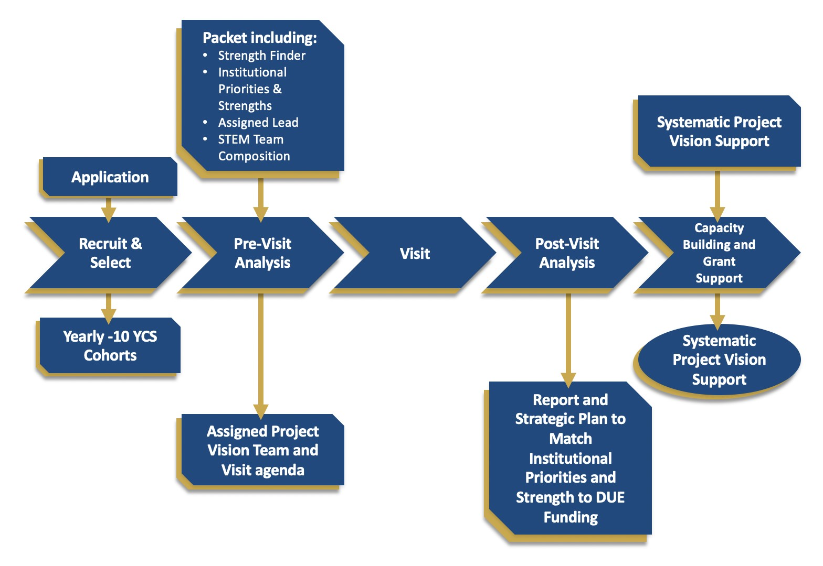
Project Vision
Five-phase Process
The diagram below provides an overview of the dynamic nature of a five-phase process that will be used to help support growth, innovation, and opportunity.
NSF Grant No. DUE 2018198 I 3209 Virginia Avenue Fort Pierce, FL 34981 I 772-462-7546 I www.projectvis.org

Slide 10
Project Vision
Mentee College Narratives
Narratives that Project Vision collects from Mentee Colleges will help frame our understanding about their institution’s background and history in areas such as organization/operation/planning/structure, administrative commitment and support, faculty engagement in visioning, ideation, and innovation, key industry partnerships, training and program development, commitment to student success and equity/inclusion/social justice, effectiveness of institutional change, and institutional commitment to sustainability.
NSF Grant No. DUE 2018198 I 3209 Virginia Avenue Fort Pierce, FL 34981 I 772-462-7546 I www.projectvis.org

Slide 11
Project Vision
Upon the completion of Pre-Visit document, the Project Vision leadership team will develop a summary document that provides a composite picture of your institution. This will be used to: (a) initiate the development of details for our site visit logistics, which will lead to joint strategy development, (b) select the Project Vision visiting team, matching areas of focus with our expertise and (c) expand dialogue with mentee colleges and external stakeholders after the post-visit in our collective journey.
Feedback loops are also designed to facilitate mutual efforts to diagnose and analyze steps or processes that may not be producing optimal outcomes in the collaboration.
NSF Grant No. DUE 2018198 I 3209 Virginia Avenue Fort Pierce, FL 34981 I 772-462-7546 I www.projectvis.org

Slide 12
Project Vision
Important note
Information that Project Visit team gathers will not be used as a summative evaluation or conclusion about your institution and/or your performance.
The relationship between the Project Vision leadership team and the mentee college team will be symbiotic and nurturing, not that of a process such as accreditation site visit or accreditation evaluators.
Nonetheless, this collaboration is aimed at developing and framing our understanding of where the mentee institution has been, where the institution is currently and where it may be headed in the future.
Our ultimate goal is to fulfill key priorities of Project Vision, Helping Colleges to InnovATE by supporting and furthering NSF investments in building capacity in STEM education and workforce development for your institution.
Through this collaboration, we will strive to ensure that you and your team will meet or exceed the aspirations of your institution to grow, prosper, and InnovATE.
NSF Grant No. DUE 2018198 I 3209 Virginia Avenue Fort Pierce, FL 34981 I 772-462-7546 I www.projectvis.org

Slide 13
Project Vision
Composition of Mentee College Team
The composition of this team is determined by each mentee college but should include senior administration, staff (grant personnel, if they exist), and multidisciplinary faculty.
Mentee College Team
Senior Administrators
Staff (grant personnel, if possible)
Multidisciplinary Faculty
NSF Grant No. DUE 2018198 I 3209 Virginia Avenue Fort Pierce, FL 34981 I 772-462-7546 I www.projectvis.org

Slide 14
Project Vision
Evaluative Data Collection
One of Project Vision’s primary objectives is to collect data and identify lessons learned. The external evaluator for Project Vision will conduct a rigorous assessment of change at each college using a Change Assessment survey.
The aggregated data will serve as means to improve Project Vision processes, inform NSF Program Officers, and assist other colleges to understand the motivators, inhibitors, and trends associated with developing grant proposals.
NSF Grant No. DUE 2018198 I 3209 Virginia Avenue Fort Pierce, FL 34981 I 772-462-7546 I www.projectvis.org

Slide 15
Project Vision
Each mentee college will also receive a personalized Case Study by being involved in NSF proposal development and capacity building in collaboration with Project Vision. This Case Study will help each mentee college to address the following:
Communication throughout mentee college
The value proposition and benefits of NSF grants for students, faculty, administrators, industry partners, and the local community. This data-rich report will be useful for a mentee college in multiple ways to:
  build the institution’s capacity to seek and pursue grant funding
  secure future buy-in across divisions
  help new faculty and administrators understand the NSF value proposition and its importance for the college to help the college to pursue external grant funding opportunities
  integrate the opportunities to seek outside grant funding into the college’s master planning and communications
NSF Grant No. DUE 2018198 I 3209 Virginia Avenue Fort Pierce, FL 34981 I 772-462-7546 I www.projectvis.org

Slide 16
Project Vision
NEXT- Change
Concerning Change -- “I haven’t got the slightest idea how to change people, but still I keep a long list of prospective candidates just incase I should ever figure it out.”
David Sedaris
NSF Grant No. DUE 2018198 I 3209 Virginia Avenue Fort Pierce, FL 34981 I 772-462-7546 I www.projectvis.org

Slide 17
Project Vision
  Promoting Change Process
As part of assessing and promoting the change processes, it will be critical that data be collected during the following three phases:
Prior to mentee college involvement with Project Vision
During the Project Vision collaboration with the mentee college
At the conclusion of the Project Vision collaboration with the mentee college
Most importantly, longitudinal survey results from three above-noted phases will help the Project Vision team to understand the changes at each mentee institution throughout its engagement with the Project Vision and potentially receiving NSF support.
To this end, the Project Vision external evaluator will email the Change Assessment survey link to the contact person at each mentee college. All STEM and CTE faculty, staff, and administrators involved in the collaboration should complete the 10-minute survey. The findings will help provide the Project Vision team with a complete picture of each mentee college.
NSF Grant No. DUE 2018198 I 3209 Virginia Avenue Fort Pierce, FL 34981 I 772-462-7546 I www.projectvis.org

Slide 18
Project Vision
The Change Assessment survey asks each mentee college to share information about grant funding knowledge, capabilities, motivators, and inhibitors from the perspectives of faculty, staff, administrators, presidents, and boards of trustees.
The Change Assessment survey findings will help identify three critical data points.
Critical Data Points
The baseline from which to measure change at each mentee college
Capacity issues needed for the development and submission of NSF ATE proposals
Gap discrepancies in perceptions between faculty and administrators that can be resolved through teamwork and effective communication
The Project Vision team in collaboration with each mentee college team aspires to facilitate a positive change process to overcome challenges associated with developing robust and credible NSF ATE grant development processes. Most importantly, Project Vision will promote strategies for sustainability, related to supporting ongoing ATE initiatives at the mentee institution.
NSF Grant No. DUE 2018198 I 3209 Virginia Avenue Fort Pierce, FL 34981 I 772-462-7546 I www.projectvis.org

Slide 19
Project Vision
Theory of Change and Change Management
Concerning Change Management Model, Project Vision team proposes the use of ADKAR¹ model.
ADKAR is an acronym that represents the five tangible and concrete outcomes that people need to achieve for lasting change: Awareness, Desire, Knowledge, Ability, and Reinforcement.
A
D
K
A
R
Awareness of the need for change
Desire to support change
Knowledge of how to change
Ability to demonstrate skills and behaviors
Reinforcement to make the change stick
Reference Citation: https://www.prosci.com/adkar/adkar-model
NSF Grant No. DUE 2018198 I 3209 Virginia Avenue Fort Pierce, FL 34981 I 772-462-7546 I www.projectvis.org

Slide 20
Project Vision
ADKAR Definition (deeper)
Awareness of the business reasons for change. Awareness is a goal or outcome of early communications related to an organizational change.
Desire to engage and participate in the change. Desire is a goal or outcome of sponsorship and resistance management.
Knowledge about how to change. Knowledge is a goal or outcome of training and coaching.
Ability to realize or implement the change at the required performance level. Ability is a goal or outcome of additional coaching, practice, and time.
Reinforcement to ensure that change sticks. Reinforcement is a goal or outcome of adoption measurement, corrective actions, and recognition of successful change.
The five pillars supporting ADKAR Model will have supporting activities that measures what worked, what did not, and why. Project Vision team will collect this data from activities that mentee college will perform throughout their cohort time period.
2. Reference Citation
https://docs.google.com/document/d/1OjIgTd2afTypN80DzDcmpd3oihUK8DOep0oR040-wsU/edit?usp=sharing
NSF Grant No. DUE 2018198 I 3209 Virginia Avenue Fort Pierce, FL 34981 I 772-462-7546 I www.projectvis.org

Slide 21
Project Vision
Project Vision team believes that change will happen because of strategies that Project Vision team and mentee college will co-create and deploy to advance the objectives of Project Vision with support from the President/CEO and Sr. Administrators. These strategies will be developed using a variety of tools and are aligned with the stages of ADKAR Model.
3209 Virginia Avenue Fort Pierce, FL 34981 I 772-462-7546 I www.projectvis.org

Slide 22
Project Vision
Diagram below is an excellent representation of how change takes place over a- period-of-time.
From current state, resistance to change, which is
To desired or future state, which is
(When the institution is not applying for NSF ATE, faculty are not incentivized, see no merit or value to do the work, very little cross campus collaboration & cooperation, lack of faculty engagement, scarce talent/capacity, Board & President who do not exhibit excitement, or demonstrate a desire to champion/advocate, key faculty leaders & administrators who are not engaged in ideation, visioning, & innovation, lack of spirit of entrepreneurship, lack of strategic approach to STEM capacity building, lack of key partnership & collaboration with employers and industries, misalignment among various planning, & lack of generative and strategic thinking.)
(When there is no resistance to change/embracing change, institution is applying for NSF ATE, faculty are incentivized, see merit or value to do the work, robust cross campus collaboration & cooperation, active faculty engagement, institutional investment in talent & capacity building, Board & President who exhibit excitement & are champions/advocates, key faculty leaders & administrators who are engaged in ideation, visioning, & innovation, a profound spirit of entrepreneurship, strategic approach to STEM capacity building, evidence of key partnership & collaboration with employers and industries, alignment among various planning exists, & generative & strategic thinking are promoted.)
3209 Virginia Avenue Fort Pierce, FL 34981 I 772-462-7546 I www.projectvis.org

Slide 23
Project Vision
Change will happen because of strategies that Project Vision team and Mentee College will co-create and deploy to advance the objectives of Project Vision with support from the President/CEO and Sr. Administrators. These strategies will be developed using a variety of tools and are aligned with the stages of ADKAR Model².
3209 Virginia Avenue Fort Pierce, FL 34981 I 772-462-7546 I www.projectvis.org

Slide 24
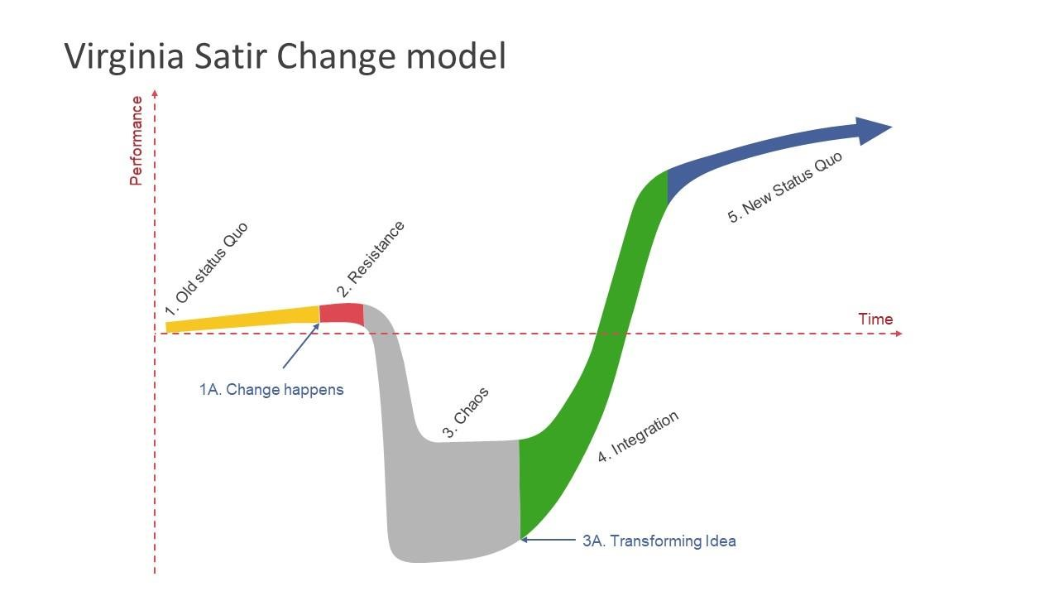
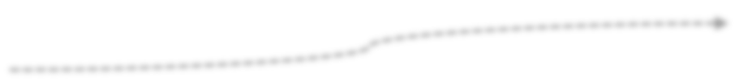
Project Vision
PV – Change Management Assessment
Survey
Case Study
Is change process taking place?
PV – Change Management Assessment
Survey
Did desired change happen?
Project Vision Survey
Mentee College Survey
Pre-Visit, Visit, Post-Visit Audit
-
3209 Virginia Avenue Fort Pierce, FL 34981 I 772-462-7546 I www.projectvis.org

Slide 25
Project Vision
Tentative Agenda Topic(s)
Professional Development Activity for Presidents/CEOs and Boards
Introduce BOTs and Presidents/CEOs to Project Vision
Identify goals and objectives of Project Vision
Evolving and changing roles of BOTs and Presidents/CEOs
Goals and objectives of this Professional Development activity
    What it is
    What it is not
Vital role of BOTs and Presidents/CEOs
Critical role of faculty and cross disciplinary engagement at the institution
  (visioning, ideation, and innovation → developing proposals → execution, and sustainability)
NSF/ATE and DUE funding programs, what are they?
How can institutions benefit from NSF ATE or other DUE Funding?
  How can ATE provide support at the institution?
    Transformative nature of NSF ATE or other DUE Funding in support of mission critical KPIs
    How can institutions renew and pivot as their market share shifts?
  How can ATE be the catalyst to develop and/or fortify existing key partnerships?
Attributes of institutions that received NSF ATE or other DUE Funding
Theory of change
Change management models
ADKAR model (Change Management Model)
How will change be measured?
Other (where do Presidents can use nudges from Project Vision team for their respective institutions?)
Q/A
3209 Virginia Avenue Fort Pierce, FL 34981 I 772-462-7546 I www.projectvis.org

Slide 26
Project Vision
Q/A
This material is based upon work supported by the National Science Foundation under Grant No. DUE 2018198. Any opinions, findings, and conclusions or recommendations expressed in this material are those of the author(s) and do not necessarily reflect the views of the National Science Foundation.
3209 Virginia Avenue Fort Pierce, FL 34981 I 772-462-7546 I www.projectvis.org

